Slide 1


Preparing your portfolio

Slide 2

Agenda
General considerations regarding your GitHub Profile
Moving your work from an ITC repository to one of your own
Solving Credentials problems
Modifying history to clean commits
Creating a React Portfolio with a working Contact Form and deploy it

Slide 3
General Considerations
Don’t use pseudonyms in your Github account.
Prefer usernames that will make employers easy to find you.
Choose a professional looking picture :)
Try to make everyday commits, even though they are small and not significantly relevant. Remember that making commits is writing history, and even though not all the commits might be that useful / significant, every little progress is a step forward

Slide 4
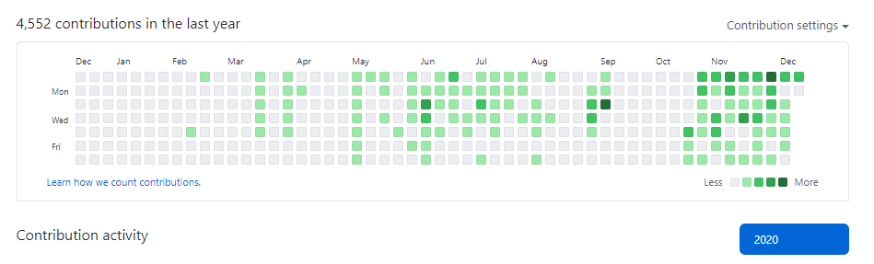
General Considerations
Employers might look to the contribution history. Aim to a populated and contribution activity.

Slide 5
General Considerations
Have in mind that it is also advisable:
Always keep an updated and clean Readme.md file.
https://guides.github.com/features/mastering-markdown/
If you can, deploy your projects and add the deployed site to the readme.

Slide 6
Moving your work to a new repository
Some of your ITC work is under ITC’s repositories. Probably, you might want to change that and push it to one of your own. Luckily, that can be easily done:
Create a new repository in your account. Prefer to create it empty: no gitignore, no readme.md, no license files. The reason? To avoid conflicts.
Set the visibility as public.
Copy the repository address.
Open a terminal window at the project location that you want to push to the new repository.

Slide 7
Moving your work to a new repository
In the location of your project, in the terminal:
git add remote <new_remote_name> <the_copied_url>
Have in mind that the name origin has already been taken by the other repository, so you can name it something else.
Afterwards adding the new remote, push to it and create a branch with the same name:
git push <new_remote_name> <new_branch_in_remote>

Slide 8
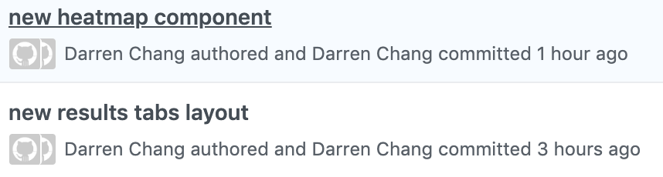
<user> authored and <user> commited
Make sure you have your credentials properly set in your local machine. A very common configuration problem i happens when your settings don’t much your Github profile.

Slide 9
<user> authored and <user> commited
To solve this inconvenient, we need to fix our configuration file in our home directory.
Now, how to access your home directory?
cd ~ // will change our location to the home directory
pwd // print the address in the terminal
code . // open the home folder in VSC
That command works for MacOS, as well in GitBash (Windows) or Ubuntu.

Slide 10
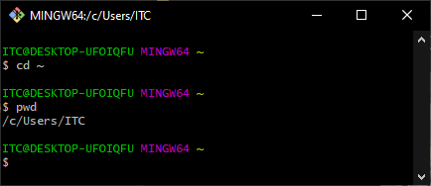
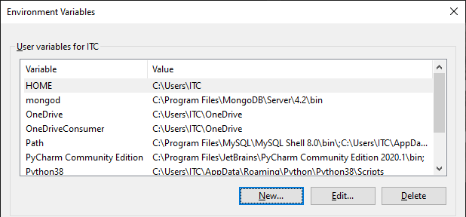
<user> authored and <user> commited
Note for Windows Users: usually, the Home directory is at:
C:/Users/<your_user_name>
Also, make sure to set an Environment Variable named HOME that points to that directory.

Slide 11
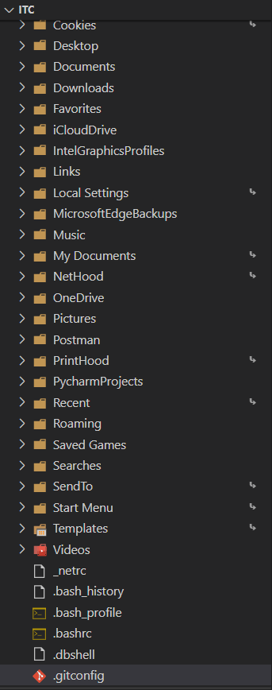
<user> authored and <user> commited
At your home location, type:
code .
A VSC Window should open at that directory. If it doesn’t, you might need to set code to open VSC.
Assuming it does, we want to modify the .gitconfig file.

Slide 12
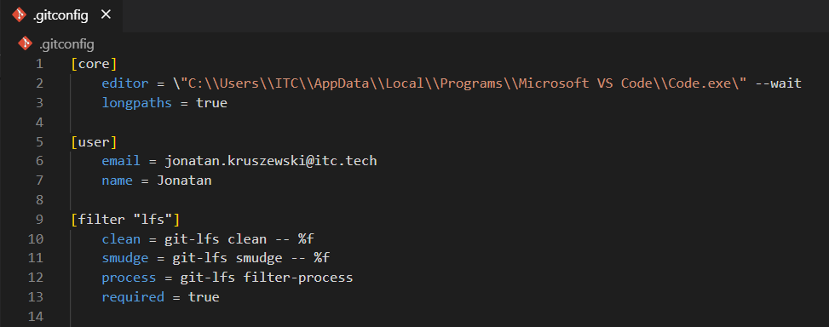
<user> authored and <user> commited
Make sure that under [user] you have an email and name values.
Your email should be the same one of your Github account.

Slide 13
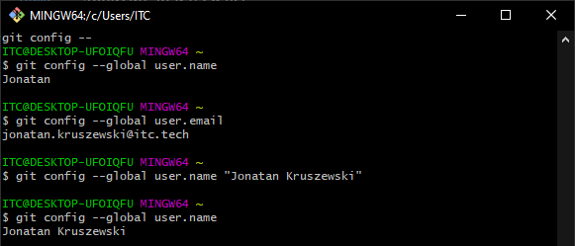
<user> authored and <user> commited
You can also set your credentials by inputting them through the terminal
git config --global user.name “Your chosen UserName”
git config --global user.email “Your Email”

Slide 14
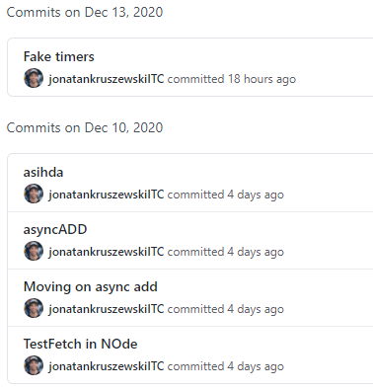
Amending history
Sometimes, when we work on a project, we don’t necessarily keep a clean commit history or might have typos:
We can fix that by modifying history. But be careful! Manipulating history with git rebase interactive, will write new commits, and other team members might need to rebase their branch to the new one.
Assuming you worked alone in your projects, let’s modify the commits and push force the new changes.

Slide 15
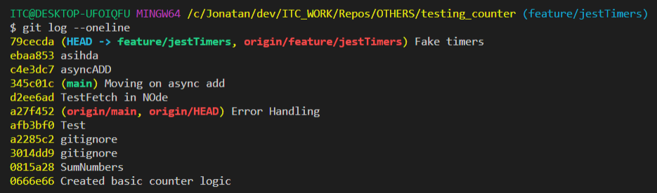
Amending history
On the branch that we want to modify the commits let’s perform first a git log:
git log --oneline
As seen, we are on the feature/jestTimers branch and we want to modify both the commits ebaa853 amd d2ee6ad. We will need to rebase 1 commit before the one we want to modify, in this case a27f452

Slide 16
Amending history
On the branch that we want to modify the commits let’s perform first a git log:
git rebase -i <commit_id or HEAD~num_of_commits>

Slide 17
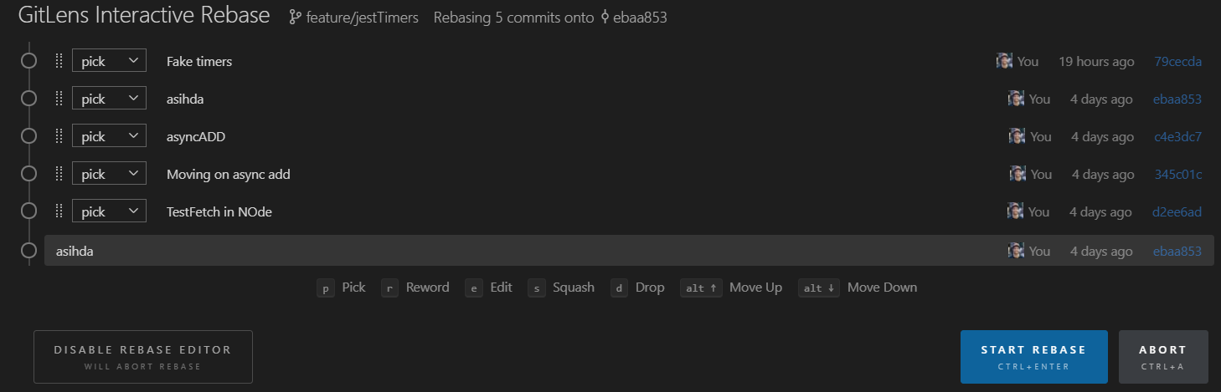
Amending history
You will see a window similar to this one. Have in mind, that in this case we are using a plugin calledgitLens - which is recommended for this operation- so it might look a little different from yours.

Slide 18
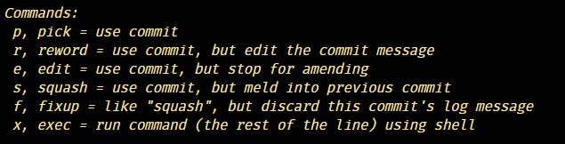
Amending history
In this window we can choose some operations for each commit:

Slide 19
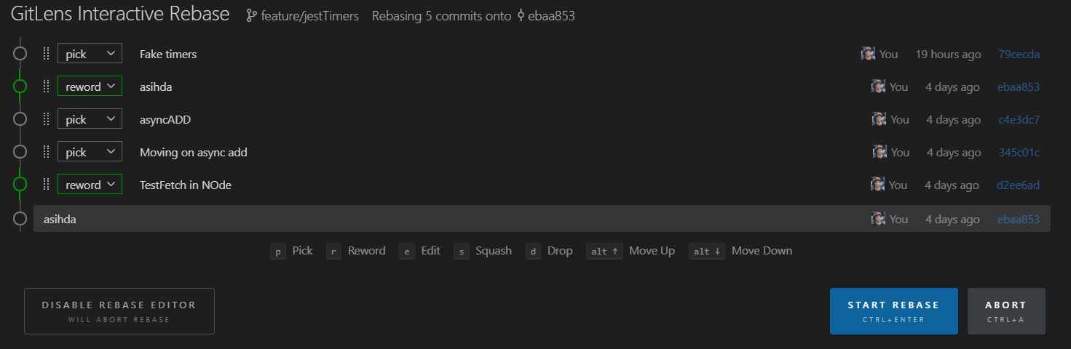
Amending history
Let’s reword those commits and start the rebase:

Slide 20
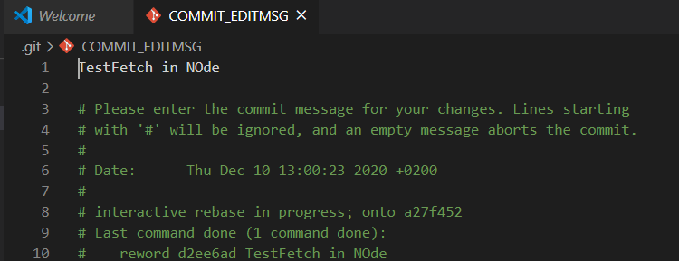

Amending history
For each commit, a new window will open. This window only modifies the commit message, but gives us several information about the commit. Let’s modify the first line, save the changes and close. Once finished, git will restart the process with each commit.

Slide 21
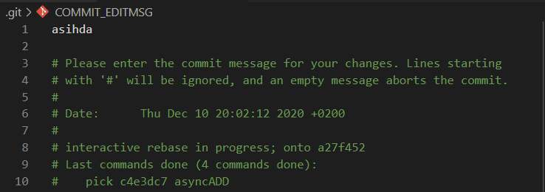
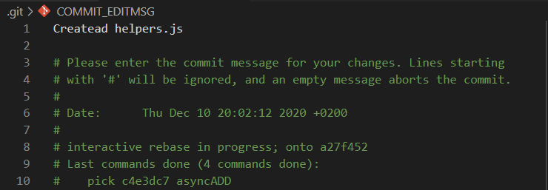
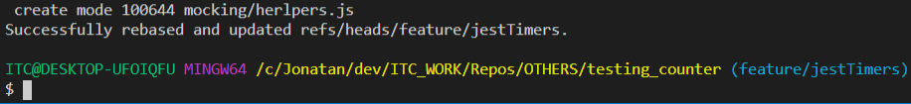
Amending history
We repeat for the second one:
And if everything went ok we should see something like this:

Slide 22
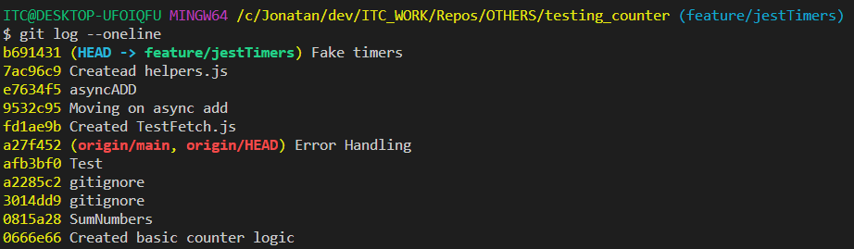
Amending history
Showing the commits log with git log --oneline we see the difference:

Slide 23
Amending history
Have in mind that modifying a commit will create new commits from the amended ones:
Before
After

Slide 24
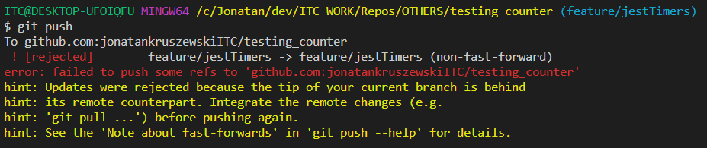
Amending history
Since the histories don’t match we will have a rejection if we try to push:
Solution:
If you are working alone, push force (use the -f flag)
If you are working on a public branch, push to a new branch and create a pull request for your manager.

Slide 25
Amending history
Since the histories don’t match we will have a rejection if we try to push:
Solution:
If you are working alone, push force (use the -f flag)
If you are working on a public branch, push to a new branch and create a pull request for your manager.

Slide 26
Content for your Repositories
You should showcase all of ITC projects.
You should update / refactor the code to make it look good on its extents (Its okay to have a CSS / JS / HTML repo) but it should be coded properly.
1 project per repo
Have small and organized commits (if not, you can amend them)
Have a professional looking profile.
Have a username that links to you.
Avoid buggy code on the main branch!
Only working code in the main. Experimental / buggy or developing features should be in another branch.
You should have an md file for each of them explaining what does the repo mean to do, and also to greet contributors.
No node_modules folder!
Don’t have 2 lock files for the projects. (yarn and npm together)

Slide 27
Content for your Repositories
If you added node_modules folder at some point, besides adding it to gitignore you might need to run this command:
git rm -r --cached node_modules

Slide 28
Working for the Hackathon
Create a branch for each feature. Have an organized naming convention
feature/signup
feature/login
To create a new branch and checkout to it: git checkout -b feature/myBranch
One person per branch (or not many)
When you are working, you constantly push to origin feature/myBranch
Afterwards you finish a feature:
git pull origin main (do it often -at least on the morning, in the noon and in the evening)
Solve the conflicts, (if so, commit after resolving conflicts)
git push origin feature/myBranch (update the branch in the remote)
git checkout main (no -b this time)
git merge feature/mybranch
git push origin main

Slide 29
Creating a React App Portfolio
There are many resources where you can extract React Portfolios templates both monetary and license free. Among them:
https://dev.to/davidepacilio/35-free-react-templates-and-themes-32ci
https://www.creative-tim.com/templates/react-free?page=1
https://mdbootstrap.com/freebies/
At any case, afterwards checking they are license free to use (and maybe it would be worth to check if you need to credit the author too) you can modify those templates to your needs, build and publish to Github Pages or any other hosting provider.

Slide 30
Disclaimer
If you are using react-router or any other router that uses the History API probably many static file servers like Github Pages won’t work.
In that case, you can choose to create a basic express server and deploy to other service, like Heroku.
In the following example, we are going to use a template that doesn’t have react-router as a dependency.

Slide 31

Creating a React App Portfolio
We are going to use this one for this example:
https://www.graphberry.com/item/mint-minimal-portfolio-html-template

Slide 32
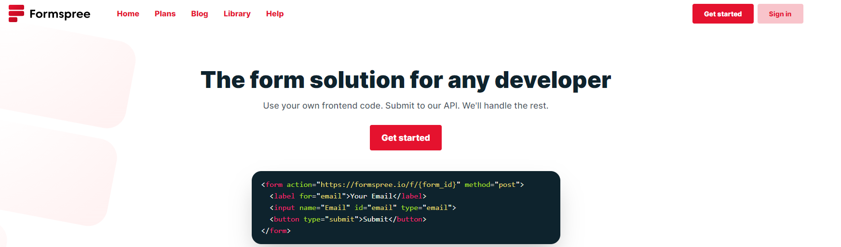
Contact Forms
An easy way to actually have a contact form in your portfolio working is to use a third party service. Among them, some of the free options are Formspree or EmailJS.

Slide 33
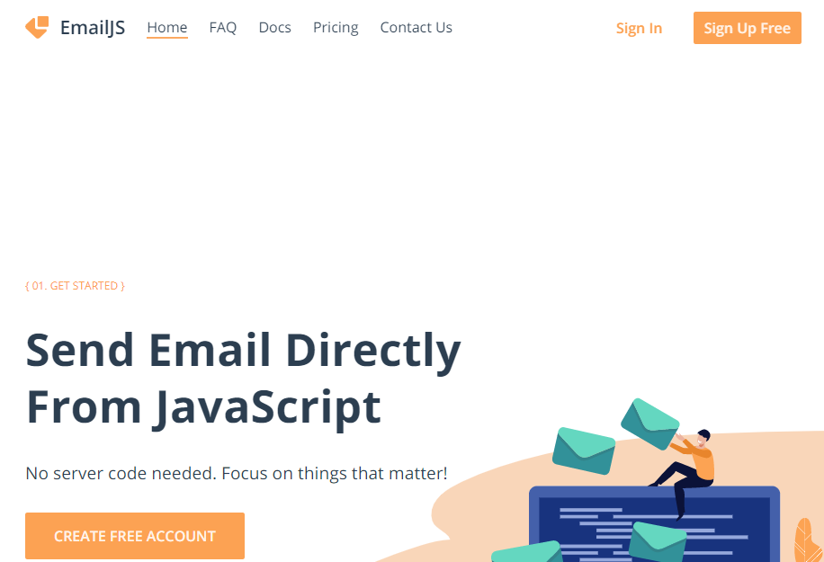
Contact Forms

Slide 34
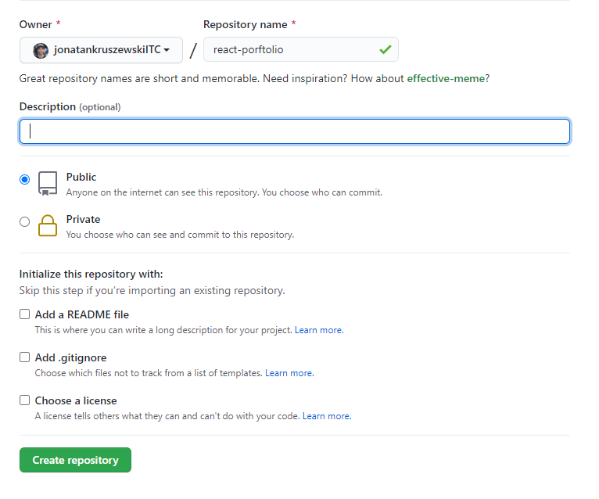
Creating a React App Portfolio
Afterwards downloading the template, lets create a new repository in our account.
We will use Github Pages to deploy the portofolio.
The documentation on how to go step by step to deploy on GitHub pages can be found on create-react-app’s documentation:
https://create-react-app.dev/docs/deployment/

Slide 35
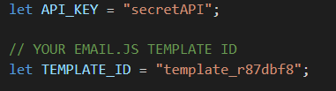
Contact Forms
In the template documentation it could be found that it has built in compatibility with EmailJS. So we will create an account there, and update the contact.jsx component:
API Keys should never be stored in a component! Instead, create a .env file in the root of the project (gitignore that file!) and paste your API key there. Let’s give a look to it:

Slide 36
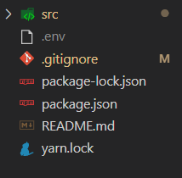

Contact Forms
In our local repository, we can create a .env file located in the root folder (check that you have react-scripts as a dependency) and name them: REACT_APP_<name placeholder>. Also, gitignore the file.
In the .env file be careful to use the = sign, and quotation marks for the values.

Slide 37
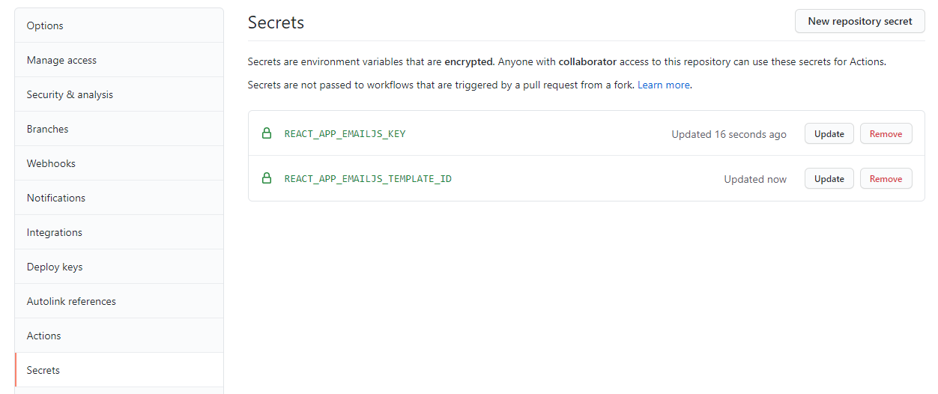
Contact Forms
Instead, we can store them in the secrets section of the repository and access them through process.env.<requested_secret>

Slide 38
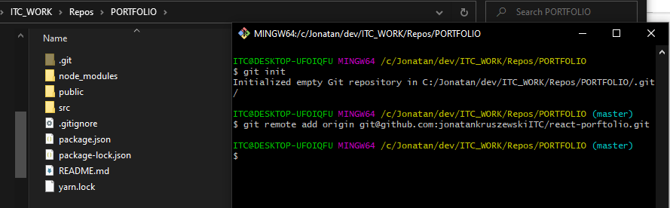
Creating a React App Portfolio

Slide 39

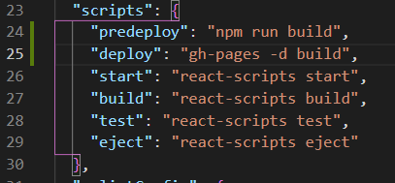
Creating a React App Portfolio
Image 01: Adding the homepage link
Image 02: Adding gh-pages as a dependency
Image 03: Adding the scripts as indicated in create react app documentation

Slide 40
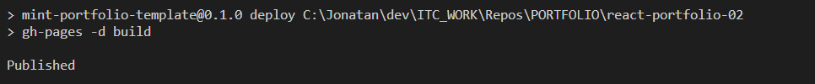
Creating a React App Portfolio
Afterwards this steps, we will be ready to deploy:
npm run deploy
We should see something like this when finished:

Slide 41
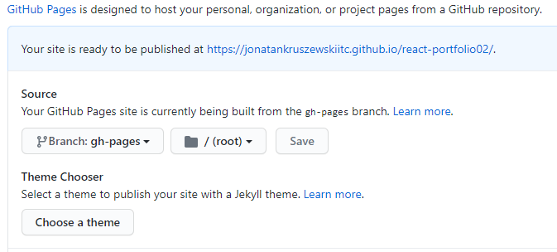
Creating a React App Portfolio
And on GitHub we can set the right branch to deploy:

Slide 42
Thanks for your time!😄

